Slide 1
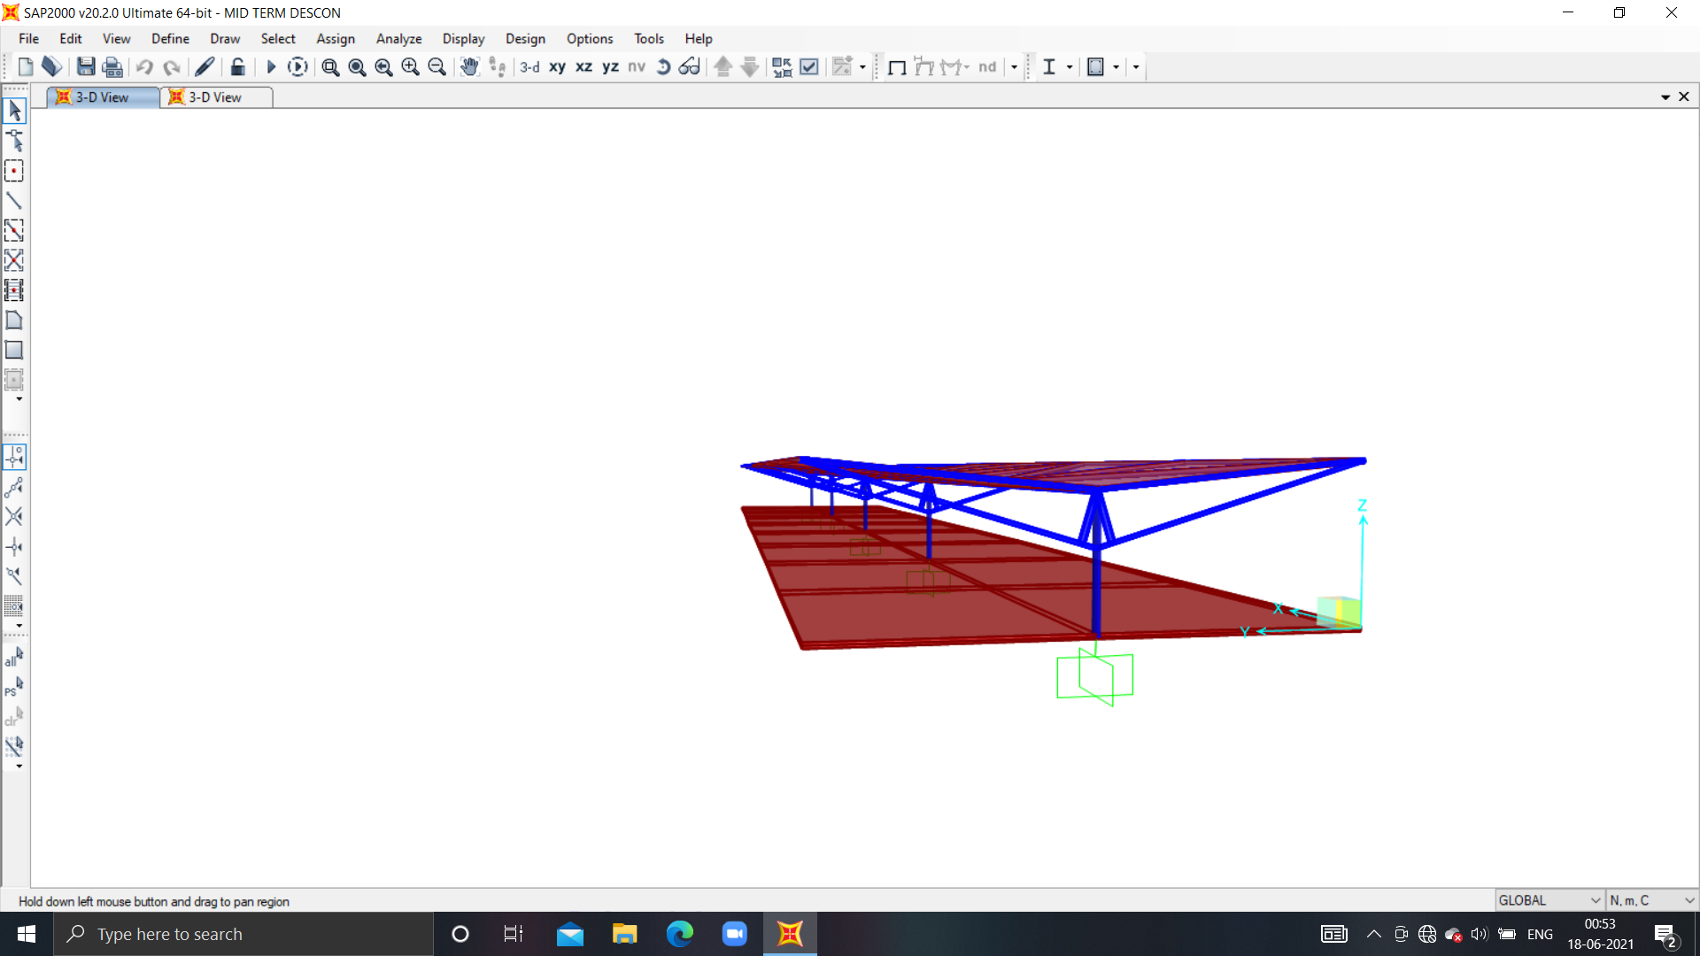
DESCON SOCIETY
ASSIGNMENT
PRESENTATION
STRUCTURE SUPER COMBO MID TERM

Slide 2
DIMENSIONS OF TRAIN STATION SHADE
LENGTH = 100 m
WIDTH = 20 m
MATERIALS USED
STAINLESS STEEL 340
CONCRETE (4000 PSI)
COST :
CONCRETE = ₹9,573.09 (per cubic yard)
SS 340 = ₹195 (per Kg)

Slide 3
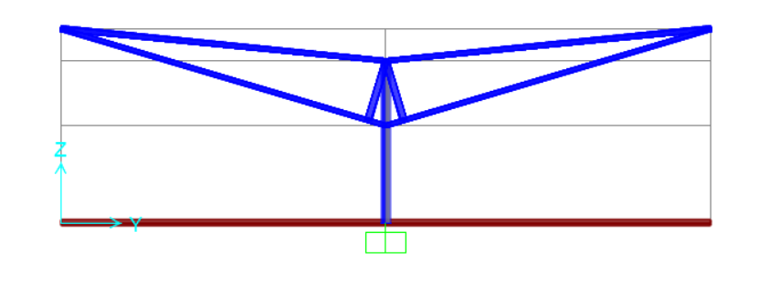
PICTURE OF UNDEFORMED STRUCTURE IN Y-Z PLANE :

Slide 4
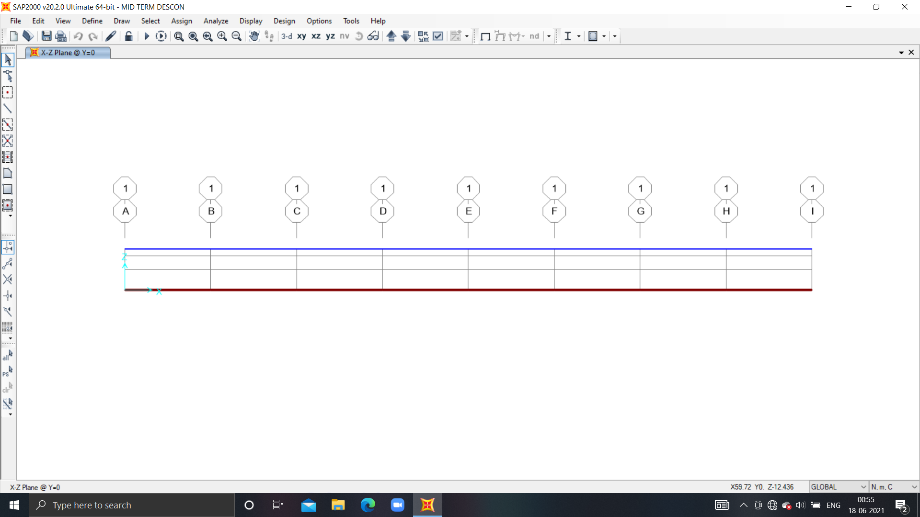
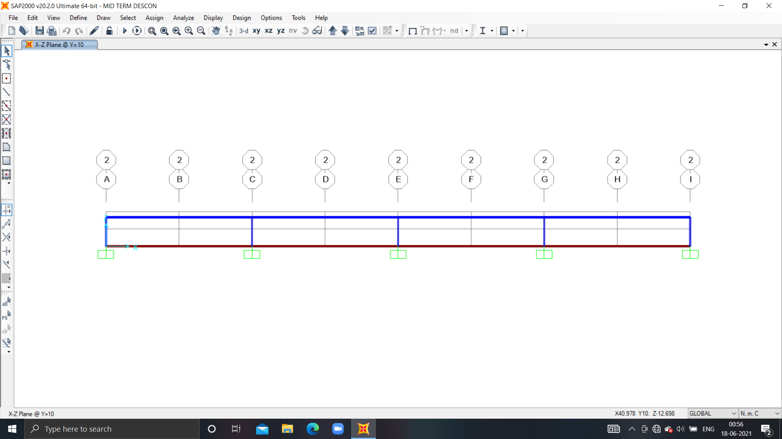
PICTURE OF UNDEFORMED STRUCTURE IN X-Z PLANE :
Y = 0 or
Y = 20
Y = 10

Slide 5
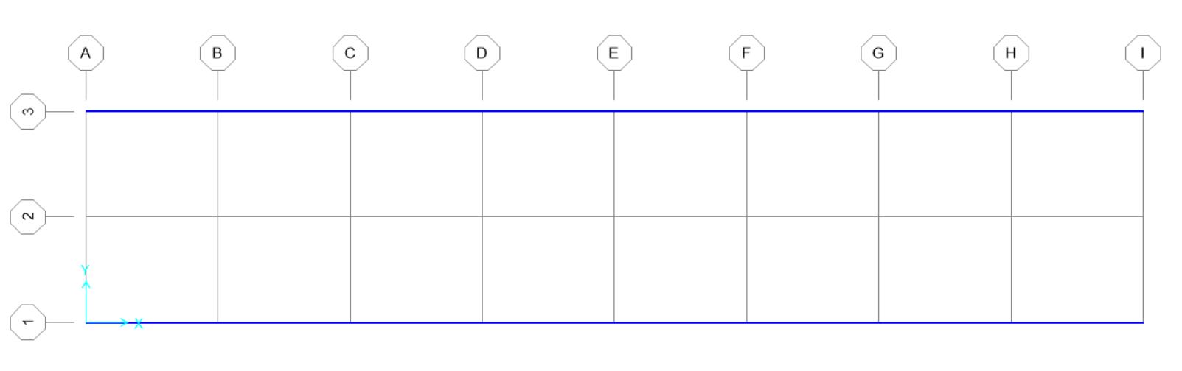
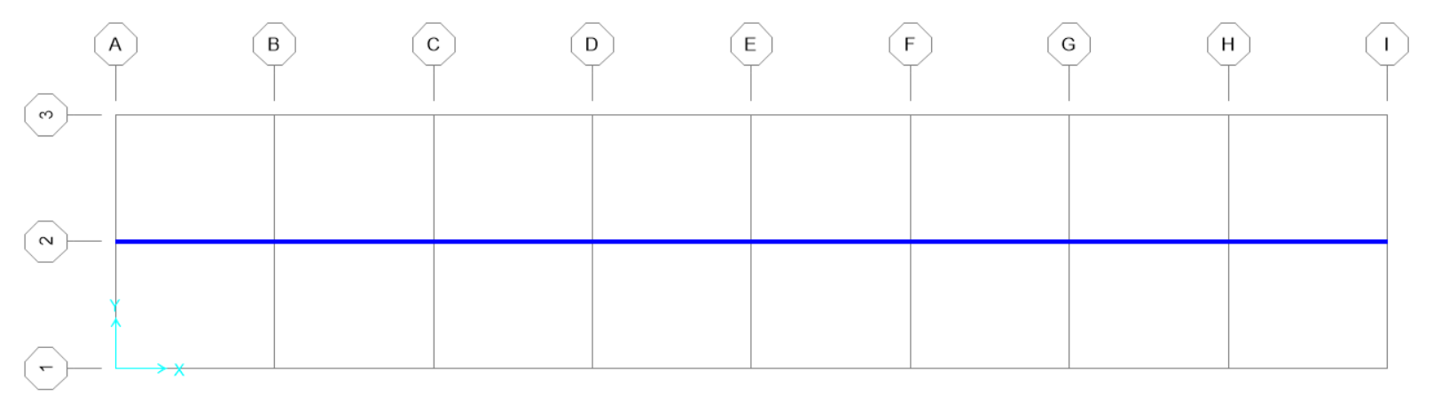
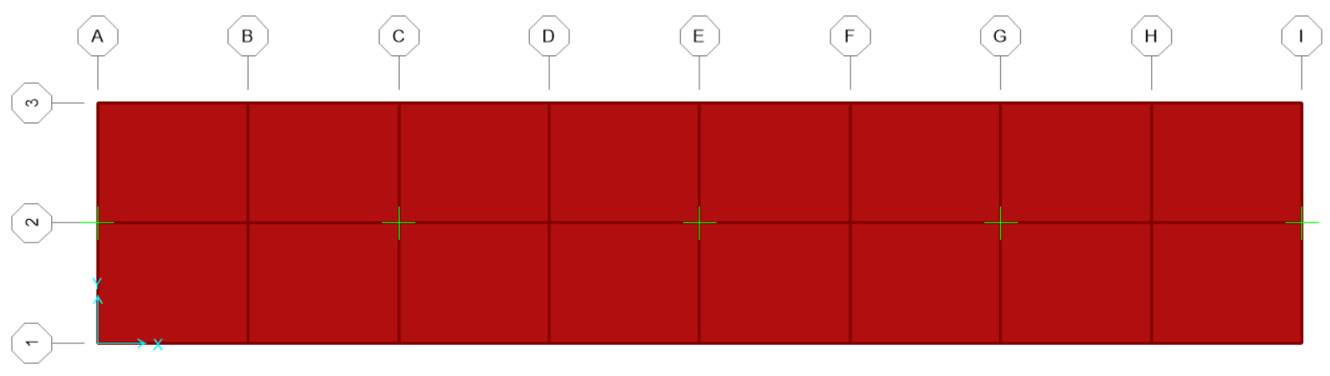
PICTURE OF UNDEFORMED STRUCTURE IN X-Y PLANE :
Z = 6
Z = 5
Z = 0

Slide 6
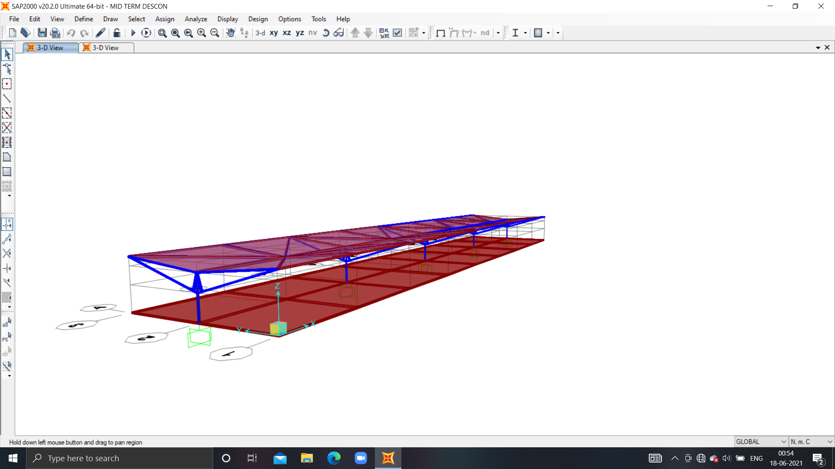
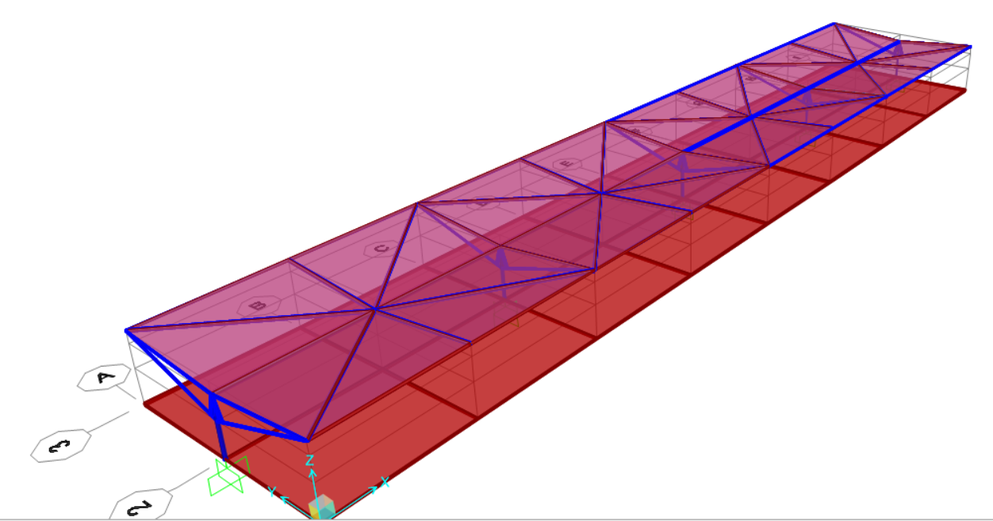
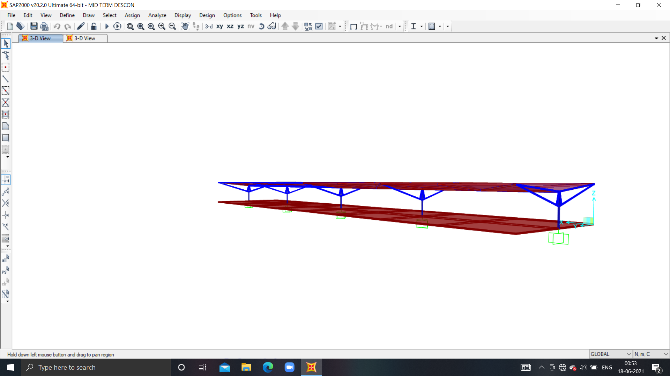
PICTURE OF UNDEFORMED STRUCTURE IN 3-D :

Slide 7
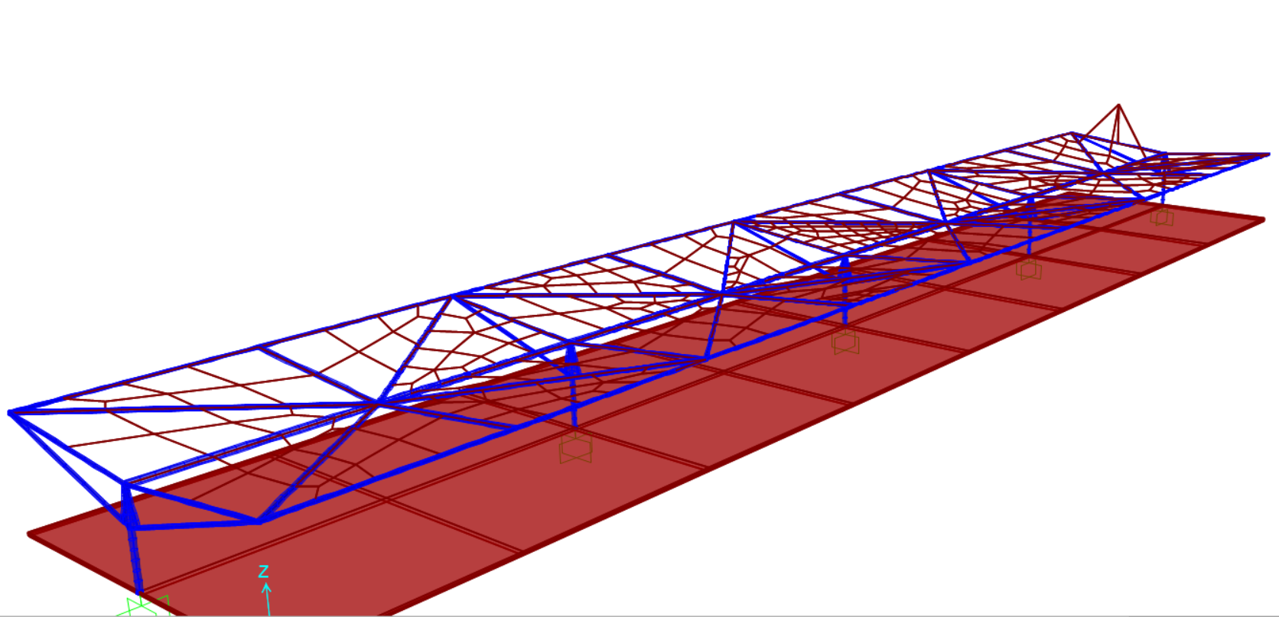
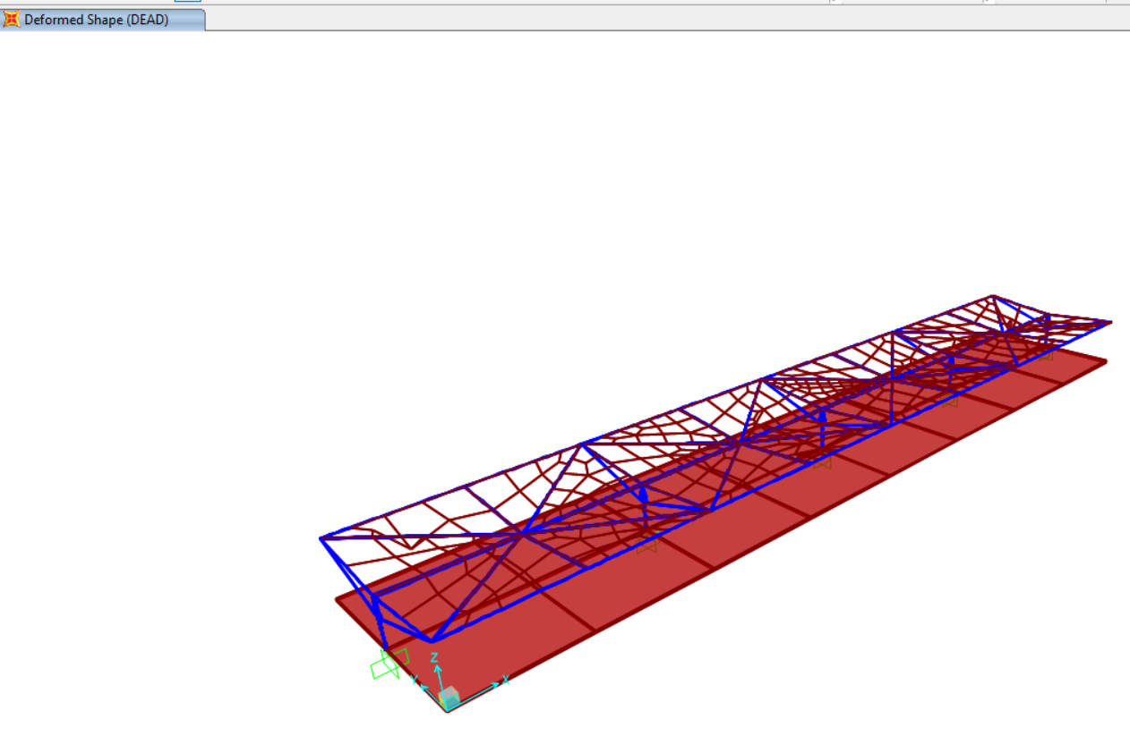
PICTURE OF DEFORMED STRUCTURE IN 3-D :

Slide 8
TOTAL COST ESTIMATION
ELEMENT | COUNT | VOLUME (in Kg) | COST ( in ₹ ) | TYPE
beam | 1 | 3524 | 687180 | SS 340
column | 5 | 431.75 | 84191 | SS 340
support | 2+10+10 | 892.808 | 174096 | SS 340
truss | 10+8+16 | 59.11+496.19+ 1583.79 | 417122 | SS 340
ROOF | 32 PLATES TRIANGULAR | 401994.88 | 5033377 | CONCRETE
Solid1 | 16 | 200000 | 2504200 | CONCRETE
 |  | TOTAL COST ➔ | 89,00,166

Slide 9
TRAIN STATION SHADE :
THE MOTIVATION BEHIND MAKING THIS STRUCTURE IS THE BASIC MODEL OF RAILWAY STATION SHADE AT VARIOUS STATIONS.
SECOND COMES THE MATERIAL,SINCE STAINLESS STEEL IS RUST FREE AND ALSO LASTS LONGER AS COMPARED TO OTHER MATERIALS.
CONCRETE IS BETTER THAN TIN SHADE SINCE METAL HEATS UP EASILY WHEREAS CONCRETE DOES BUT SLOWLY.
MAKING THE MODEL EFFICIENT WAS THE GOAL AND ALSO THIS STRUCTURE HAS VERY LESS DEFORMTION.

Slide 10
SOURCES :
RATES OF CONCRETE https://www.wingrastone.com/wingra-redi-mix/pricing/
RATES OF STAINLESS STEEL
https://www.fastwell.in/304-stainless-steel-supplier-manufacturer.html

Slide 11
THANK YOU
BY : PRIYA SINGH
ROLL NO. :200728

